Slide 1
Machine Learning For Enhanced Fraud Detection
Presented by Ethan Soo
3rd June 2020

Slide 2

Agenda
Application
Imbalanced dataset
Supervised machine learning model
Putting it all together

Slide 3
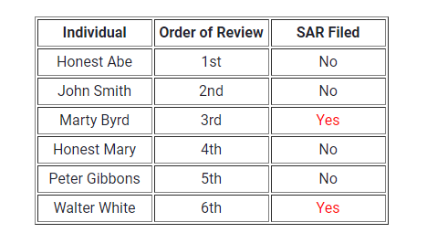

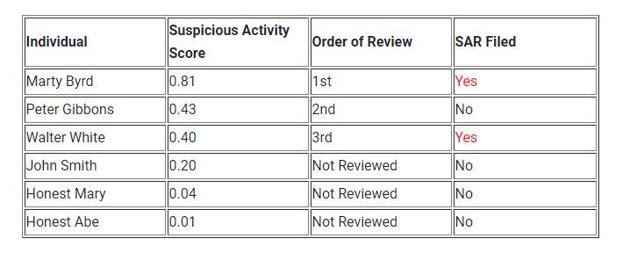
Application – Suspicious Activity Report

Slide 4

Issues – Imbalanced dataset
Slight Imbalances (1:10) vs Sever Imbalances (1:100)
Biased or skewed model
Accuracy Paradox

Slide 5
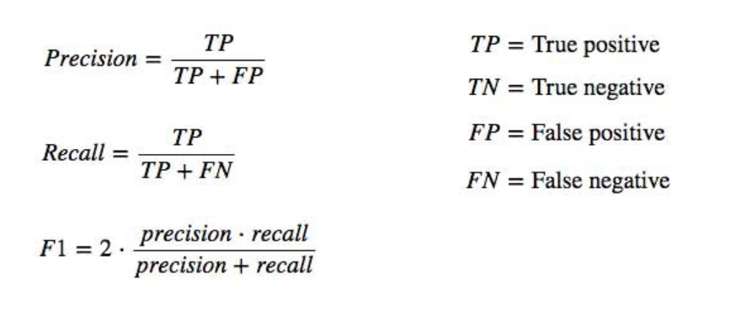

Solution – Imbalanced dataset
Change performance metric
Undersampling Minority
Oversampling Minority
Generate Synthetic Samples (SMOTE)

Slide 6
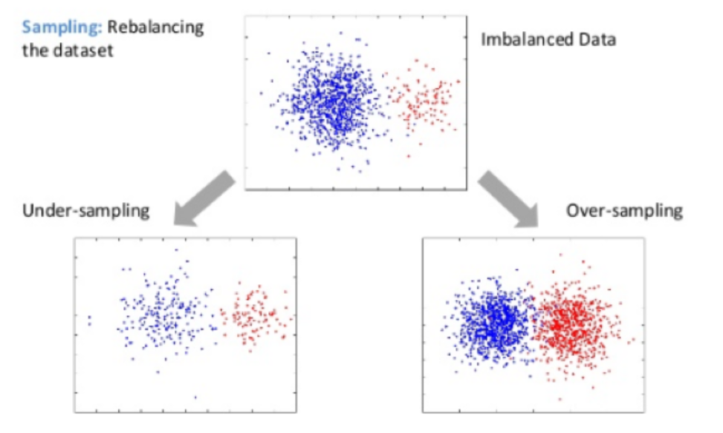
Solution – Imbalanced dataset
Change performance metric
Undersampling Majority
Oversampling Minority
Generate Synthetic Samples (SMOTE)

Slide 7
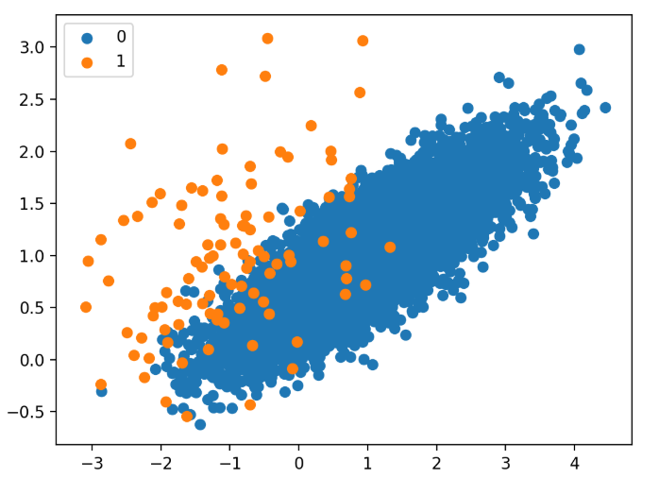
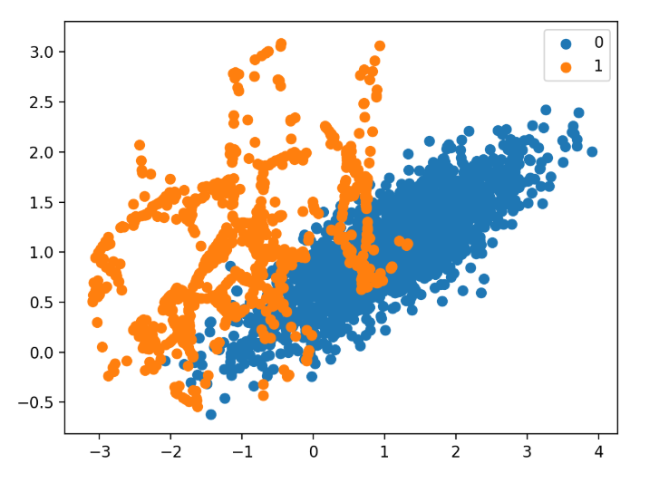
Solution – Imbalanced dataset
Change performance metric
Undersampling Minority
Oversampling Minority
Synthetic Minority Oversampling Technique (SMOTE)

Slide 8
Supervised ML Model Selection
“Predicting Good Probabilities With Supervised Learning”
Calibrated Boosted Trees
        XGBoost
            Execution speed
            Ensemble of weak learners
Random Forests
Support Vector Machine

Slide 9
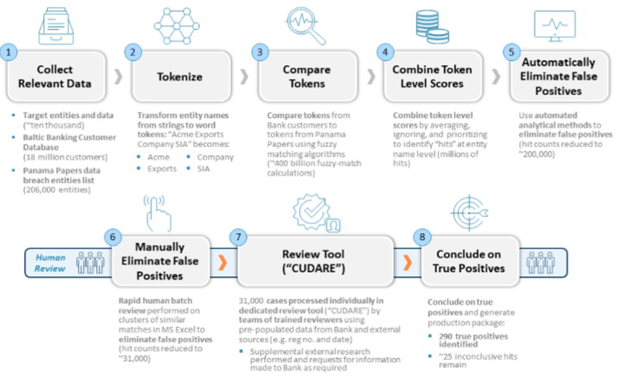
Application

Slide 10
Proof of Concept
Exploratory Data Analysis
Feature Engineering
Artificial Balancing
Model Selection
Probability Calibration
Synthetic Financial Dataset For Fraud Detection
> 90% Recall
HOW SHOULD THE PREDICTED DATA BE USED?

Slide 11
Thank you!

